Slide 1

American Community Survey - 2010 – 2014 Albert Alva | Rob Rivens | Samira Zarandioon

Slide 2
American Community Survey - 2010 – 2014 Albert Alva | Rob Rivens | Samira Zarandioon
Extract Executive Summary
Our analysis will focus on education and economic data. We will explore economic characteristics relating to educational institutions from grade-level, housing and school district lenses. We will also perform spatial analyses on the data. We hope to uncover patterns related to urban vs rural areas, areas exhibiting exponential population growth, as well as the impact of affluence and poverty on highest level of schooling attained by households.
In researching economic data by US school district, we found startling trends in the data related to highest level of education attained as well as gender. The data showed that there were dominate states that clearly depicted higher salaries than other US states. By slicing and dicing the data at a location level, we were able to uncover trends which lend credence to claims that males are compensated more heavily than females with similar schooling…

Slide 3
Average salaries across the Unites States range from a low of $28K/year in Mississippi, to a high of $50K/year in New Jersey…

Slide 4
New Jersey dominates salary at all degree levels…
Males in Jersey dominate!

Slide 5
How did we get here?
We found our dataset on the internet, downloaded in it’s raw format.
We had to cleanse the data, as it initially had extraneous information such as ”margin of error”
Some of the values were negative, which were obviously data entry errors, since salary cannot be less than zero
We removed “zeroes” from the data, as we did not want averages to be skewed by these values
We used mySQL to import our tables and ran queries to add descriptive data to our raw dataset
We also used Microsoft Excel to perform more analysis, utilizing pivot tables, auto-filters and graphing functions

Slide 6
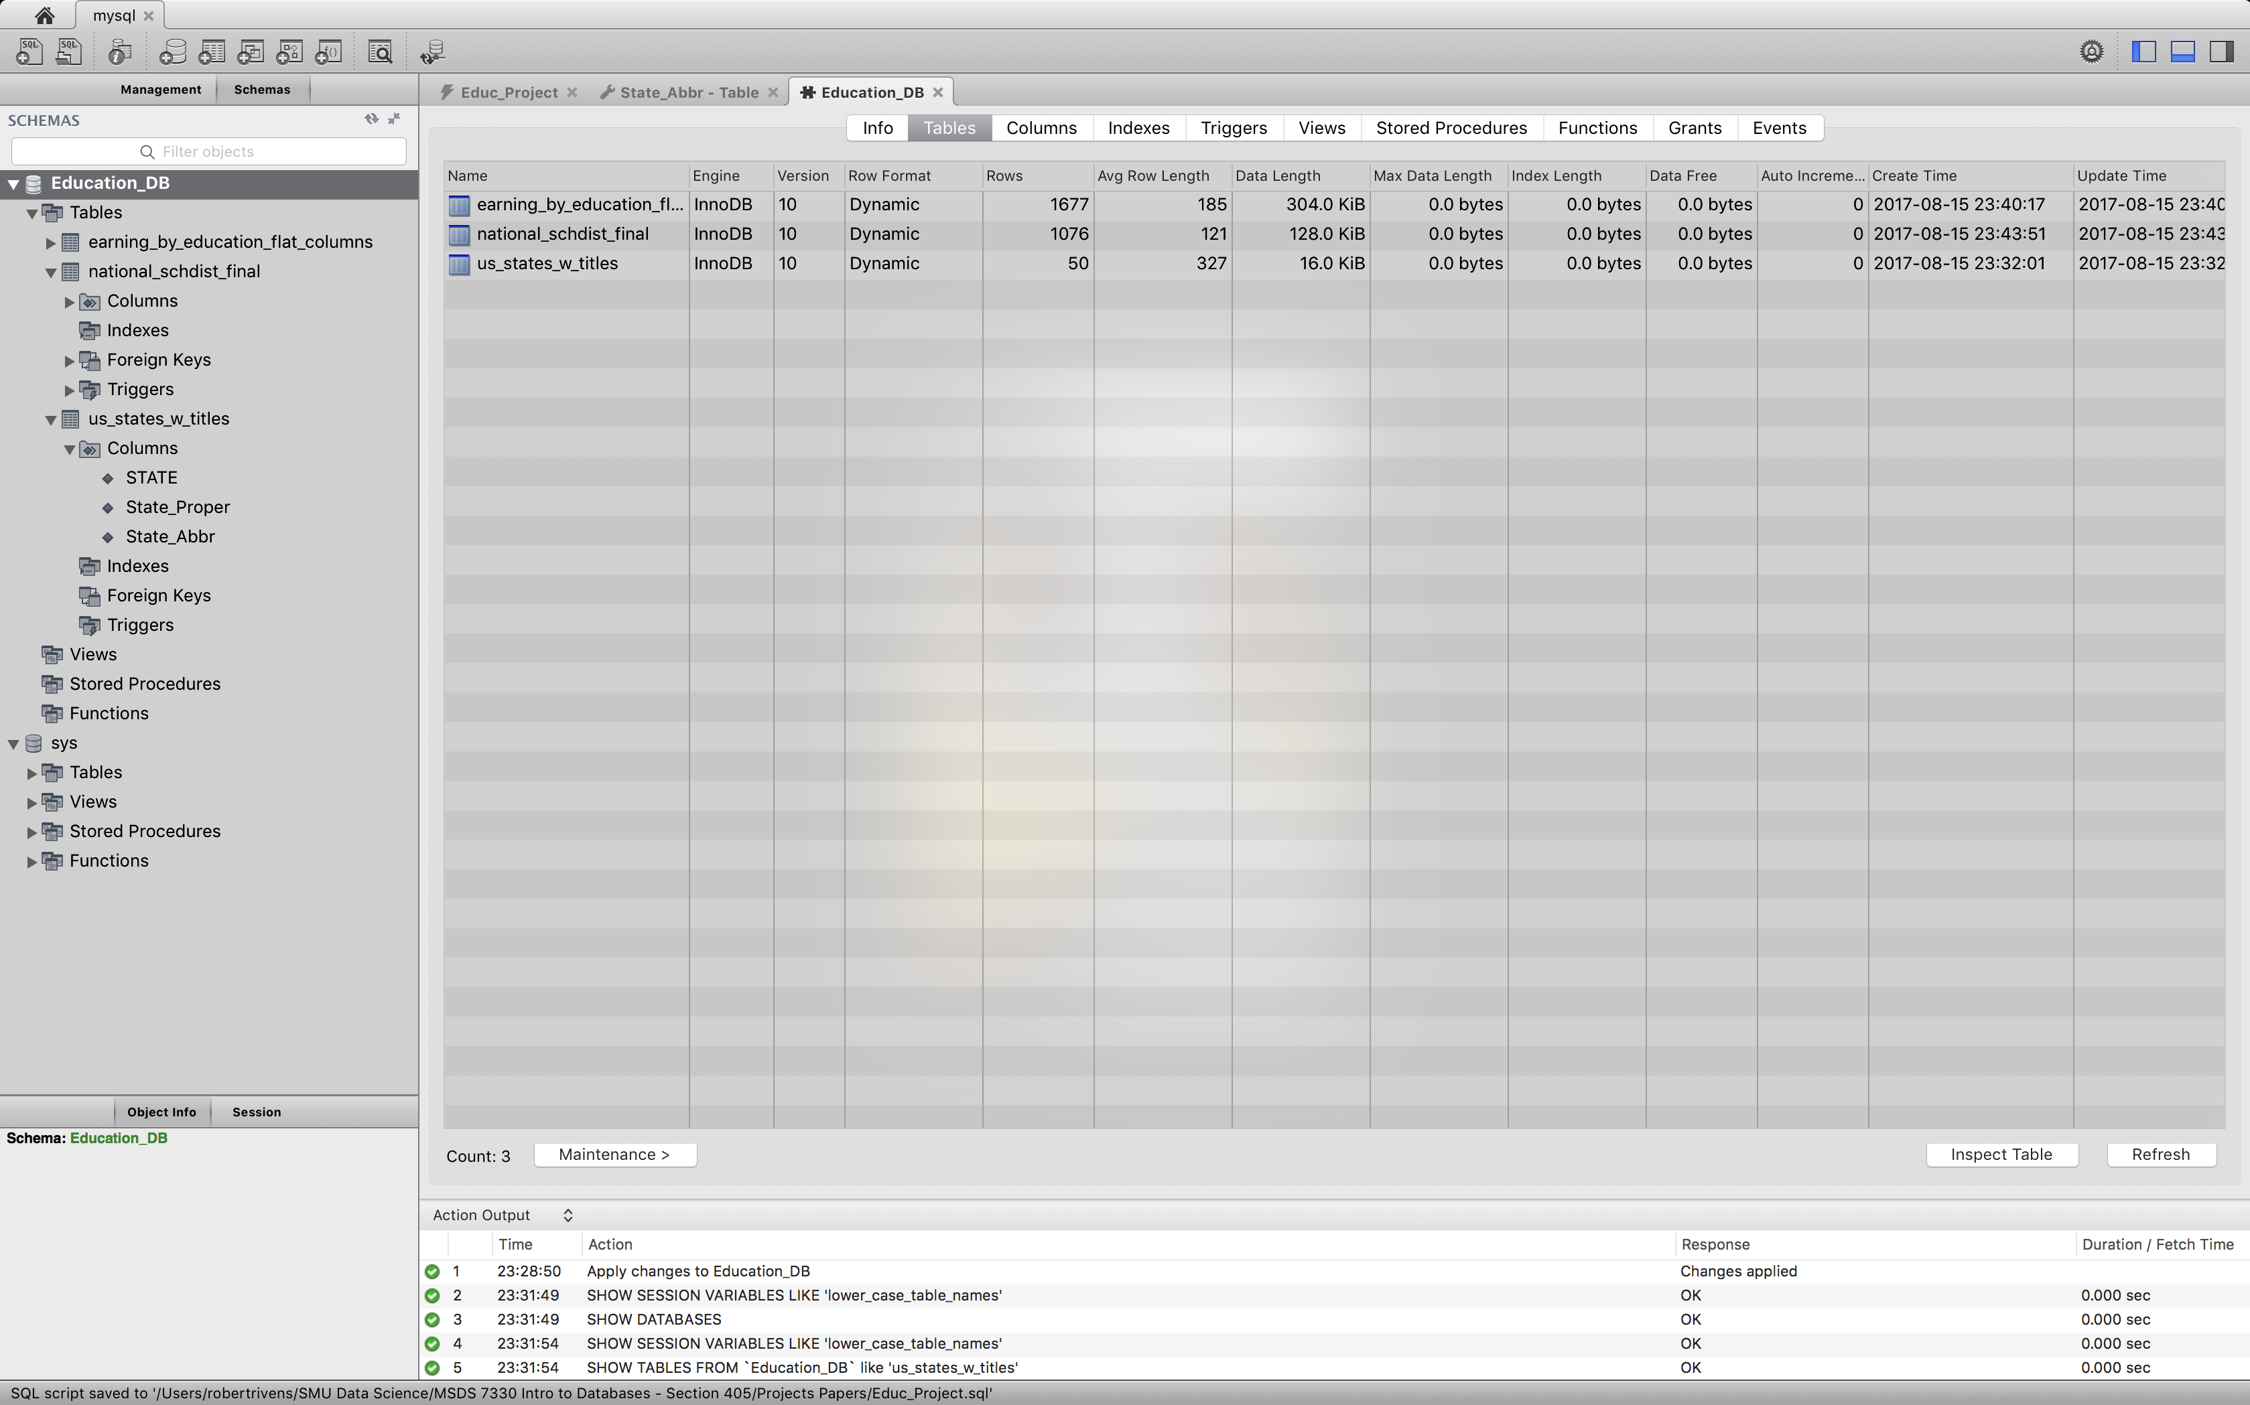
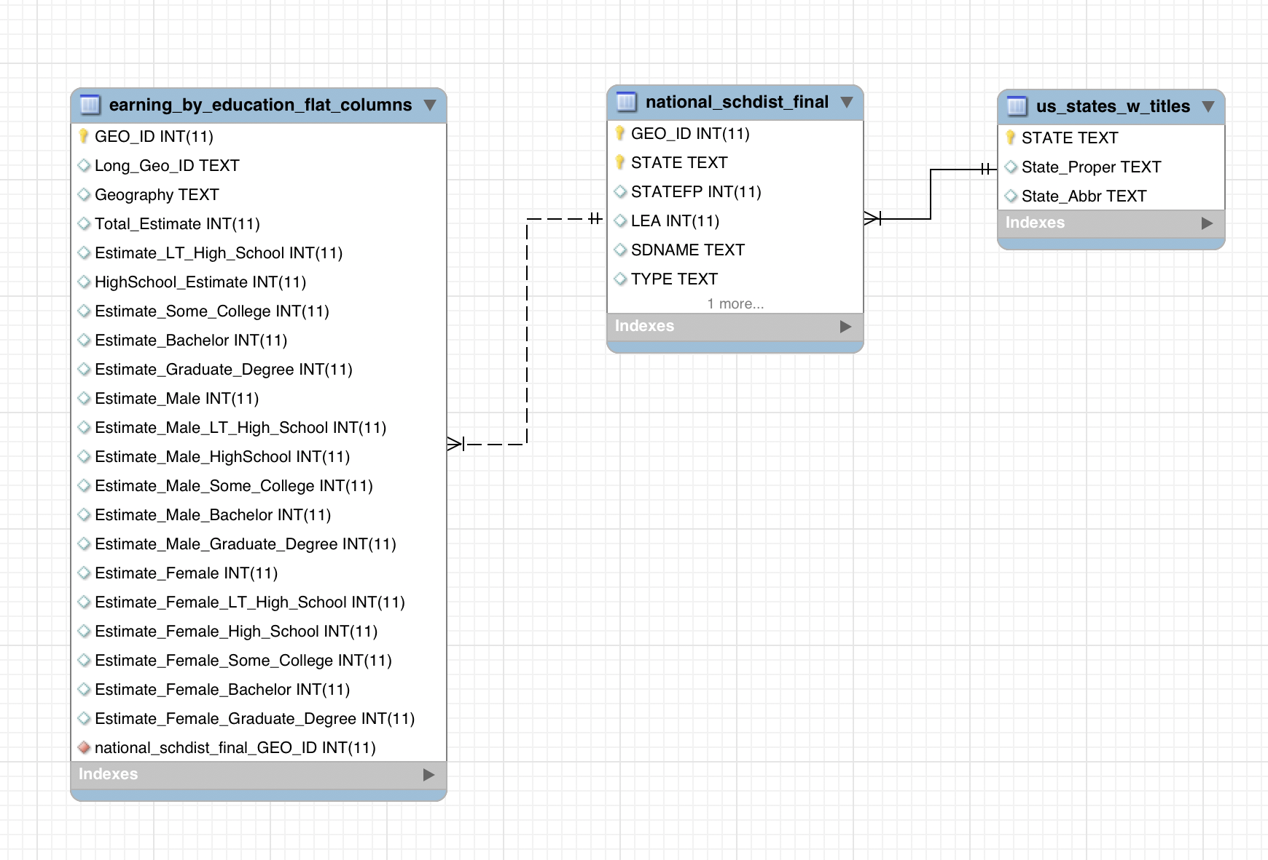
Database Schema

Slide 7
Technical Stuff…
DATA:
Education Data (2.3MB): https://nces.ed.gov/programs/edge/tables.aspx?ds=acs&y=2014
School District Geo Code Translation Table (752KB):
https://www.census.gov/geo/reference/geoidentifiers.html
State Abbreviation Translation Table:
http://www.whypad.com/posts/excel-spreadsheet-of-us-states/583/

Slide 8

Technical Stuff…
HARDWARE: MacBook Pro
Touch Bar and Touch ID 2.9GHz Processor 512GB Storage
2.9GHz quad-core 7th-generation Intel Core i7 processor
Turbo Boost up to 3.9GHz
16GB 2133MHz LPDDR3 memory
512GB SSD storage¹
Radeon Pro 560 with 4GB memory
Four Thunderbolt 3 ports
Touch Bar and Touch ID

